Slide 1
P03 A Lost Civilisation 6th Presentation
A113 – Mathematics

Slide 2
Symbols
Humans use symbols to represent quantities.
Some of the symbols developed from different civilizations are as follows:
Hindu-Arabic | 0 | 1 | 2 | 3 | 4 | 5 | 6 | 7 | 8 | 9
Roman Numeral |  | I | II | III | IV | V | VI | VII | VIII | IX
Chinese | 零 | 一 | 二 | 三 | 四 | 五 | 六 | 七 | 八 | 九

Slide 3
Symbols
It is inconvenient to create a new symbol to represent the next larger quantity every time the need arises.
Thus, humans designed a systematic way of combining existing symbols to represent larger quantities.
For example, in the Roman numeral system, the symbols “I” and “V” can be combined to represent different quantities like “IV”, “VI”, “VII” and “VIII”.

Slide 4
The symbol that represents “nothing”
Humans discovered that it is convenient to have a symbol to represent “nothing”.
In the decimal system, the symbol “0” is used to represent “nothing”.
In the lost civilisation mentioned in the worksheet, “V” is used to represent “nothing”.

Slide 5
Position of symbols
In the process of combining symbols to represent quantities, the positions of the various symbols make a difference to the meaning of the quantities they represent.
For example, in the decimal system, interchanging the positions of the pair of the symbols “3” and “4” will represent different quantities, i.e.
“34” is not equal to “43”
Although “0” itself represents nothing, the position of “0” will affect the meaning of the resultant quantities, e.g.
012 102 1002

Slide 6
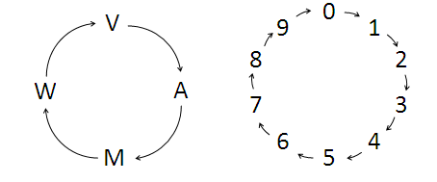
The positioning method
In the positioning method, each time the quantity is increased by one, the rightmost symbol will change.
As there are only a fixed number of symbols used, the symbols will change in a cyclic manner as shown below:
Four symbols used by the lost civilisation
Ten symbols in the decimal system

Slide 7
The positioning method
We will use the symbols of the lost civilisation in the worksheet to illustrate the positioning method:
… VVVVV - “nothing”
… VVVVA - •
… VVVVM - ••
… VVVVW - •••
… VVVAV - ••••
… VVVAA - •••••
If all the symbols on the left are “V”, they can be ignored because they do not represent any quantities.
When “W” changes to “V”, the symbol on its immediate left changes.
The process continues.

Slide 8
The binary number system
The binary number system uses the symbols “0” and “1” to represent quantities. It is also known as the base 2 number system.
Below is the illustration of the positioning method of the binary number system:
0000000 - “nothing”
0000001 - •
0000010 - • •
When “1” changes to “0”, the symbol on its immediate left changes to “1”.

Slide 9
The binary number system
The binary number system uses the symbols “0” and “1” to represent quantities. It is also known as the base 2 number system.
Below is the illustration of the positioning method of the binary number system:
0000000 - “nothing”
0000001 - •
0000010 - • •
0000011 - • • •
0000100 - • • • •
0000101 - • • • • •
When “1” changes to “0”, the symbol on its immediate left changes to “1”.
When the rightmost “1” changes to “0” again, the “1” on its immediate left change to “0” which in turn causes the “0” on the third position to change to “1”.
The process continues.

Slide 10
Common number systems
 | Decimal (Base 10) | Binary (Base 2) | Octal (Base 8) | Hexadecimal (Base 16)
 | 0, 1, 2, 3, 4, 5, 6, 7, 8, 9 | 0, 1 | 0, 1, 2, 3 4, 5, 6, 7 | 0, 1, 2, 3, 4, 5, 6, 7, 8, 9, A, B, C, D, E, F
Nothing | 0 | 0₂ | 0₈ | 0₁₆
One | 1 | 1₂ | 1₈ | 1₁₆
Two | 2 | 10₂ | 2₈ | 2₁₆
Three | 3 | 11₂ | 3₈ | 3₁₆
Four | 4 | 100₂ | 4₈ | 4₁₆
Five | 5 | 101₂ | 5₈ | 5₁₆
Six | 6 | 110₂ | 6₈ | 6₁₆
Seven | 7 | 111₂ | 7₈ | 7₁₆
Eight | 8 | 1000₂ | 10₈ | 8₁₆
Nine | 9 | 1001₂ | 11₈ | 9₁₆
Ten | 10 | 1010₂ | 12₈ | A₁₆
Eleven | 11 | 1011₂ | 13₈ | B₁₆
Twelve | 12 | 1100₂ | 14₈ | C₁₆
Thirteen | 13 | 1101₂ | 15₈ | D₁₆
Fourteen | 14 | 1110₂ | 16₈ | E₁₆
Fifteen | 15 | 1111₂ | 17₈ | F₁₆

Slide 11

Conversion from other base system to decimal
For example, to convert 11101₂ from base 2 to base 10, we can do the following:
Step 1: Determine the positional value of each digit. This corresponds to increasing powers of the base of the number system, starting with 0 power from the rightmost position.
Step 2: Multiply the digits by the positional values in the corresponding columns and sum the products. The obtained value is the equivalent decimal number.
Hence, 11101₂ = 29

Slide 12
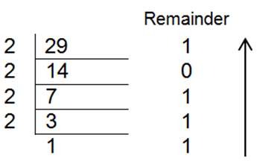
Conversion from decimal to other base system
For example, to convert 29 from decimal (base 10) to binary (base 2), we can use the following long division method:
Step 1: Divide the decimal number to be converted by the value of the new base. Record the remainder and quotient as shown.
Step 2: Divide the quotient of the previous division by the new base. Record the remainder and quotient as shown.
Step 3: Repeat Step 2 until the quotient becomes less than the new base. The rearranged remainder, from bottom to top, is the equivalent value of the new base number.
1
1
copy
Hence, 29 = 11101₂

Slide 13
Conversion between other base systems
We have already learnt how to convert from other base numbers to decimal and vice versa. Hence, to do conversion between other base systems, we can do the following:
Alternatively, we can also use grouping method as a shortcut to convert from binary to octal or hexadecimal number system.
Step 1: Convert the original base number to a decimal number.
Step 2: Convert the decimal number to the new base number.

Slide 14
Conversion between other base systems
Let us look at the example of binary number:
101011100110₂
To convert the binary number to octal, divide the digits into groups of three and convert each group of three binary digits to one octal digit.
Binary 101 011 100 110
Octal 5 3 4 6
Hence, 101011100110₂ = 5346₈
To convert the binary number to hexadecimal, divide the digits into groups of four and convert each group of four binary digits to one hexadecimal digit.
Binary 1010 1110 0110
Hexadecimal A E 6
Hence, 101011100110₂ = AE6₁₆

Slide 15
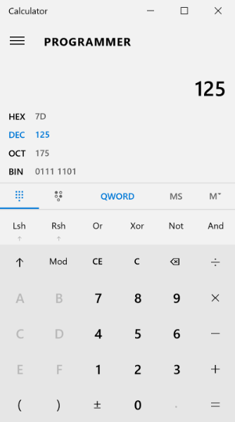
Windows 10 Calculator (Programmer Mode)
Alternative, you may use the windows calculator.
Switch to programmer mode using this tab.
Select the input number system, e.g. decimal.
Key in the value, e.g. 125. Conversions to other number systems such as Binary, Octal and Hexadecimal will be shown.

Slide 16
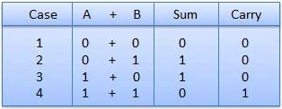

Addition and Subtraction
We can make use of the following table when performing addition in the binary number system:
For example, we can add the quantities 101₂ and 111₂ as follow:

Slide 17

Addition and Subtraction
The subtraction of binary numbers follows the same rules as the subtraction of numbers in the decimal number system. The only variation is one borrows a group of 2 in the binary system.
For example, we can subtract the quantity 101₂ from 1010₂ as follows:

Slide 18
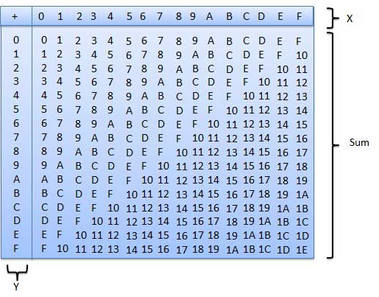
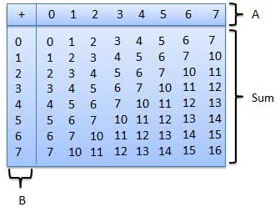
Addition and Subtraction
Similarly, we can make use of the following tables when performing addition in the octal and hexadecimal number systems:

Slide 19
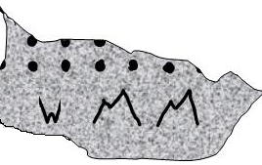
Putting it together
A broken stone tablet (with the inscription “WMM”) was excavated as shown in Figure 2 below.
Figure 2
WMM₄ = 3×4² + 2×4¹ + 2×4⁰ = 48 + 8 + 2 = 58
If it is intact, we would expect to see 58 dots.

Slide 20
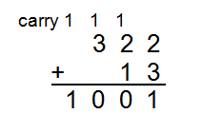
Putting it together
Suppose the scientists found another stone tablet with the inscription “AW”.
WMM₄ + AW₄ = AVVA₄
AVVA₄ = 1×4³ + 0×4² + 0×4¹ + 1×4⁰ = 64 + 1 = 65
Therefore, we would expect to see a total of 65 dots.

Slide 21
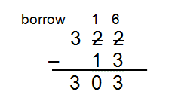
Putting it together
If “AW” was subtracted from “WMM”, we can convert the symbols to their numerical representation first before carrying out the subtraction.
WMM₄ ‒ AW₄ = WVW₄
Therefore, we would expect to see the symbols “WVW” representing the value when “AW” was subtracted from “WMM”.

Slide 22
Learning Objectives
Explain the basic building blocks of a number system.
Identify different types of number systems.
Convert numbers from one number system to another number system.
Perform addition and subtraction under a specific number system.

Slide 23
Exploring Further – Binary Multiplication
Let us determine what is the product of 101₂ and 11₂.
It is actually quite similar to multiplication in the decimal number system:
Hence 101₂ x 11₂ = 1111₂

